Slide 1

Instahyre
INSTAHYRE JOB
ANALYTICS
Extracting Insights from Professional Networking Platform
PRESENTED BY
Divye Chopra
Amit Kotnala
Harsha Hari
Shamsul Qumar

Slide 2
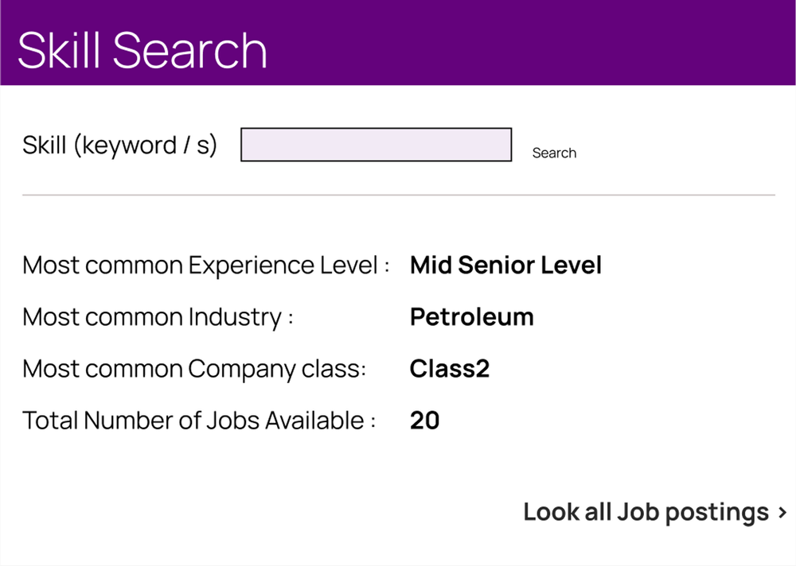
OBJECTIVE & SCOPE
Scrape Data from Instahyre
Use Clustering Model to Create Company Classes
Create a Web App which returns Class, Count of Jobs, Seniority level and Industry
Data Analysis and Visualisation
This project aims to scrape job data from Instahyre, apply clustering algorithms to group companies based on job postings, and create a web application for users to explore company classes, job counts, seniority levels, and industries based on the skill searched.

Slide 3

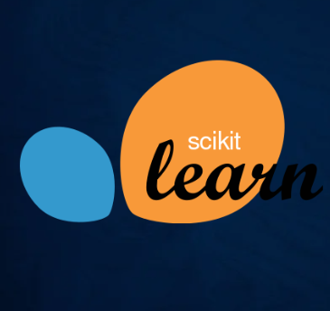
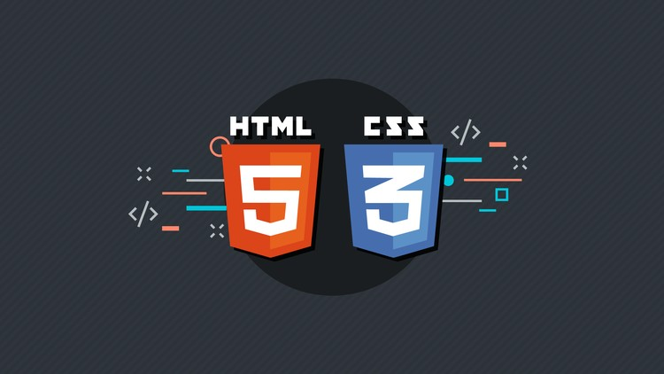
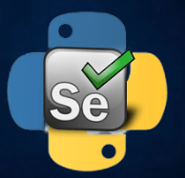

TOOLS USED
Python
Sklearn
HTML/CSS
Flask
Selenium

Slide 4



Phase 1
WEB
SCRAPING
Utilised the flexibility of python libraries like Selenium, Regex and Pandas to scrape www.instahyre.com
Extracted Three tables:
Jobs
Company
Details

Slide 5

Phase 1
DATA
PRE-PROCESSING
Data Wrangling
Univariate Analysis
Deleted Redundant Columns
Merged tables to Create a Final

Slide 6
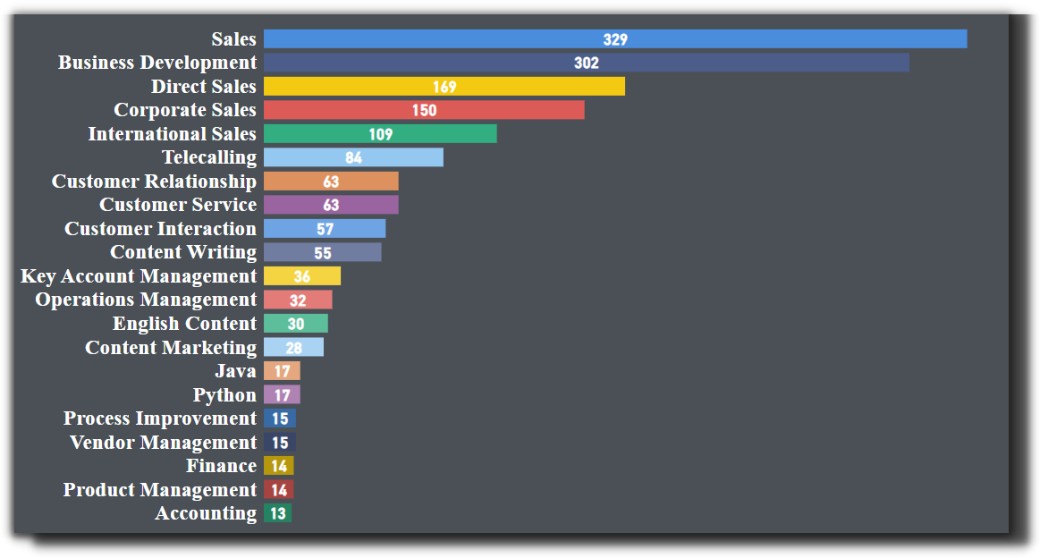
Phase 1
INSIGHTS
Most Mentioned Skills

Slide 7
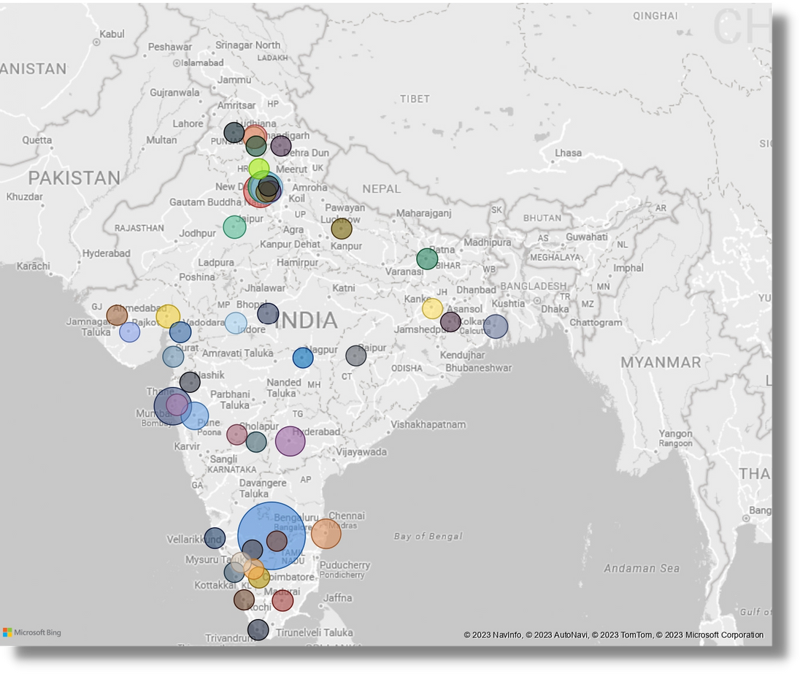
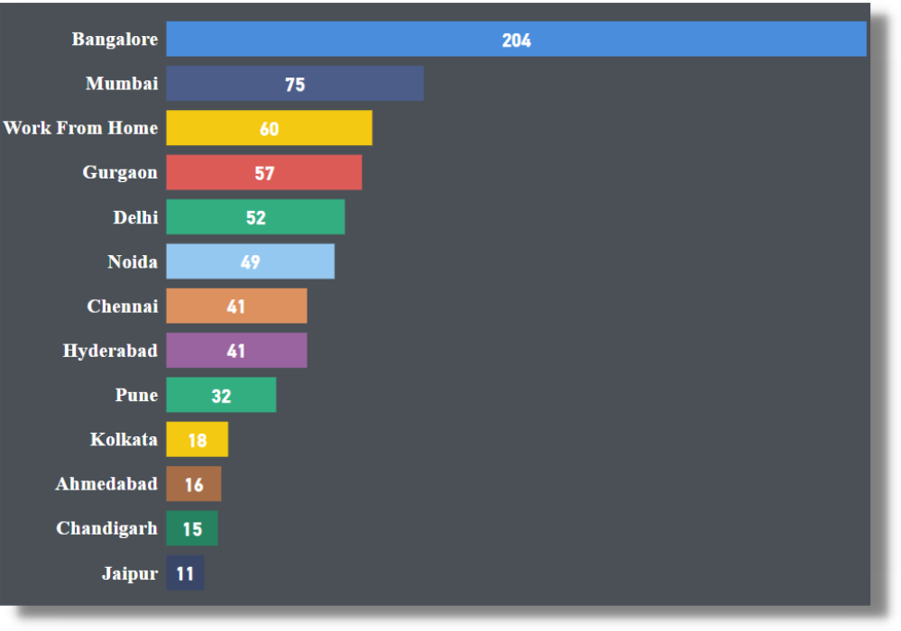
Phase 1
INSIGHTS
Dominating Cities In India

Slide 8
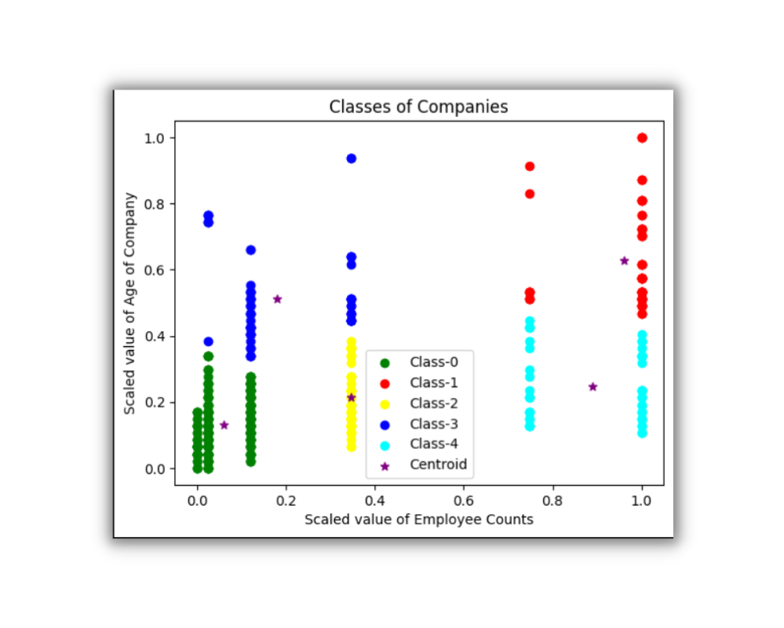
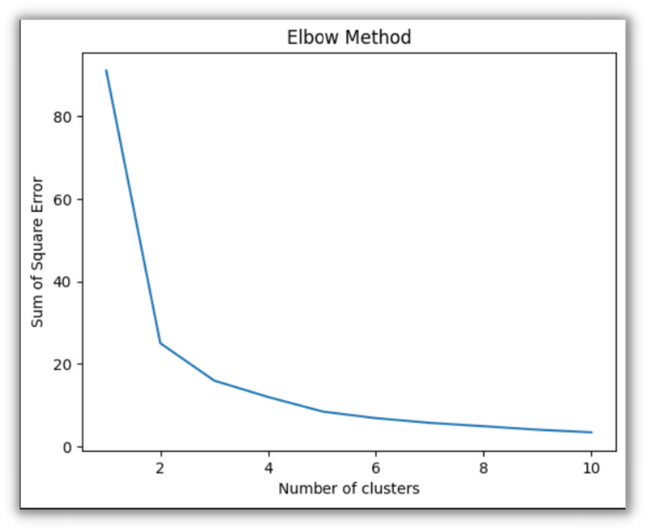
Phase 2
MODEL BUILDING
Features:-
Age Of Company, Employee_count
Used Elbow Method to get the
Number of Clusters
Build a K-Means Clustering Model
(Unsupervised Learning)

Slide 9
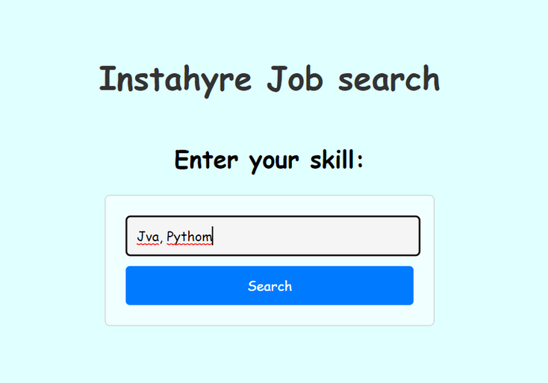
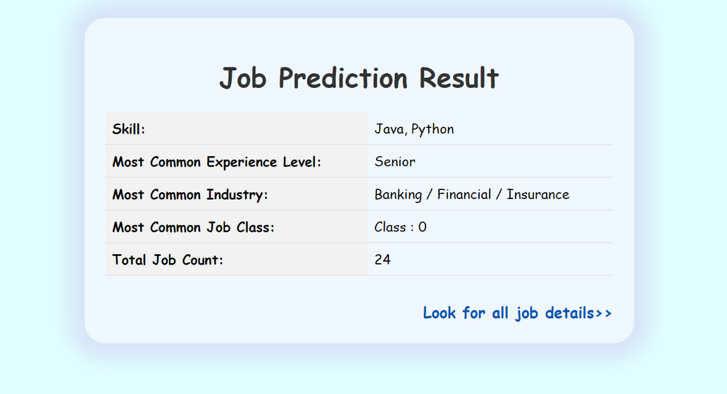
Phase 2
APP CREATION
Created different functions for skill search
Used Flask to deploy Web App on Local Host
Used HTML/CSS Templates to Display App

Slide 10

CHALLENGES FACED
Creating Webpage with the help of HTML and CSS
User Input Text Processing and learning Fuzzy wuzzy
Creating a backend with flask and returning output to webpage
Understanding the different ways to deploy the model

Slide 11


FUTURE SCOPE
Deploy the Model on Web Server
Text Processing Can be improved for more accuracy
Enhance the UI interface with more interactive features

Slide 12

LEARNING OUTCOMES
SELENIUM
FLASK
HTML/CSS

Slide 13


